Slide 1



Business Insights 360
View in Power BI
Last data refresh:
01/10/2024 14:35:25 UTC
Downloaded at:
01/10/2024 14:43:57 UTC

Slide 2
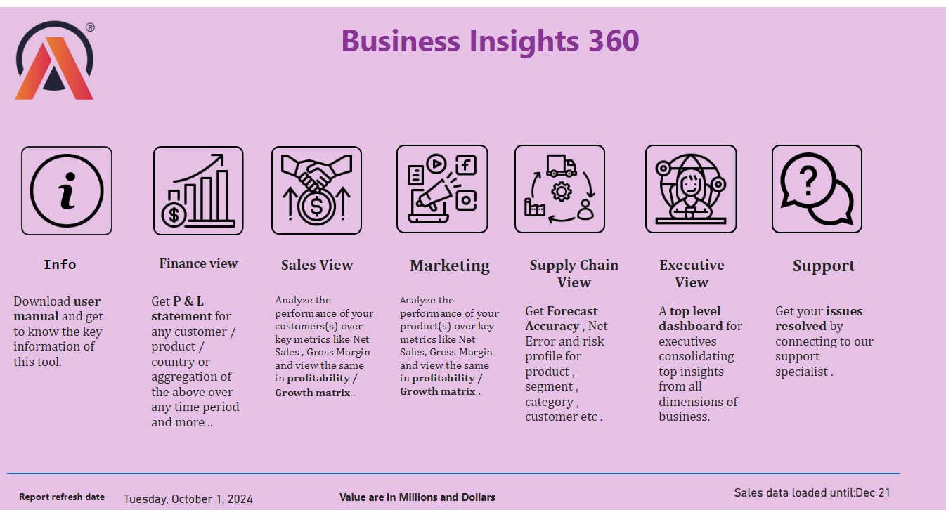
home page
Notes:
shape
No alt text provided
card
No alt text provided
textbox
No alt text provided
textbox
No alt text provided
card
No alt text provided
image
No alt text provided
image
No alt text provided
image
No alt text provided
image
No alt text provided
image
No alt text provided
image
No alt text provided
image
No alt text provided
image
No alt text provided
textbox
No alt text provided
textbox
No alt text provided
textbox
No alt text provided
textbox
No alt text provided
textbox
No alt text provided
textbox
No alt text provided
textbox
No alt text provided
textbox
No alt text provided
textbox
No alt text provided
textbox
No alt text provided
textbox
No alt text provided
textbox
No alt text provided
textbox
No alt text provided
textbox
No alt text provided
textbox
No alt text provided

Slide 3
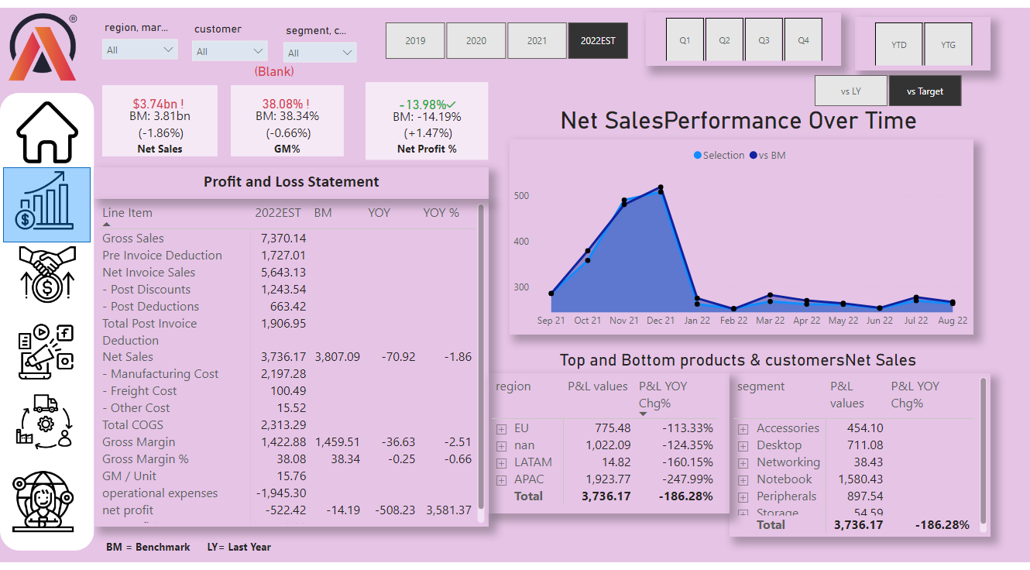
finance view
Notes:
slicer
No alt text provided
textbox
No alt text provided
card
No alt text provided
pivotTable
No alt text provided
slicer
No alt text provided
slicer
No alt text provided
slicer
No alt text provided
Net SalesPerformance Over Time
No alt text provided
pivotTable
No alt text provided
pivotTable
No alt text provided
slicer
No alt text provided
slicer
No alt text provided
slicer
No alt text provided
image
No alt text provided
shape
No alt text provided
image
No alt text provided
image
No alt text provided
image
No alt text provided
image
No alt text provided
image
No alt text provided
textbox
No alt text provided
shape
No alt text provided
card
No alt text provided
card
No alt text provided
kpi
No alt text provided
textbox
No alt text provided
kpi
No alt text provided
textbox
No alt text provided
kpi
No alt text provided
textbox
No alt text provided
image
No alt text provided

Slide 4
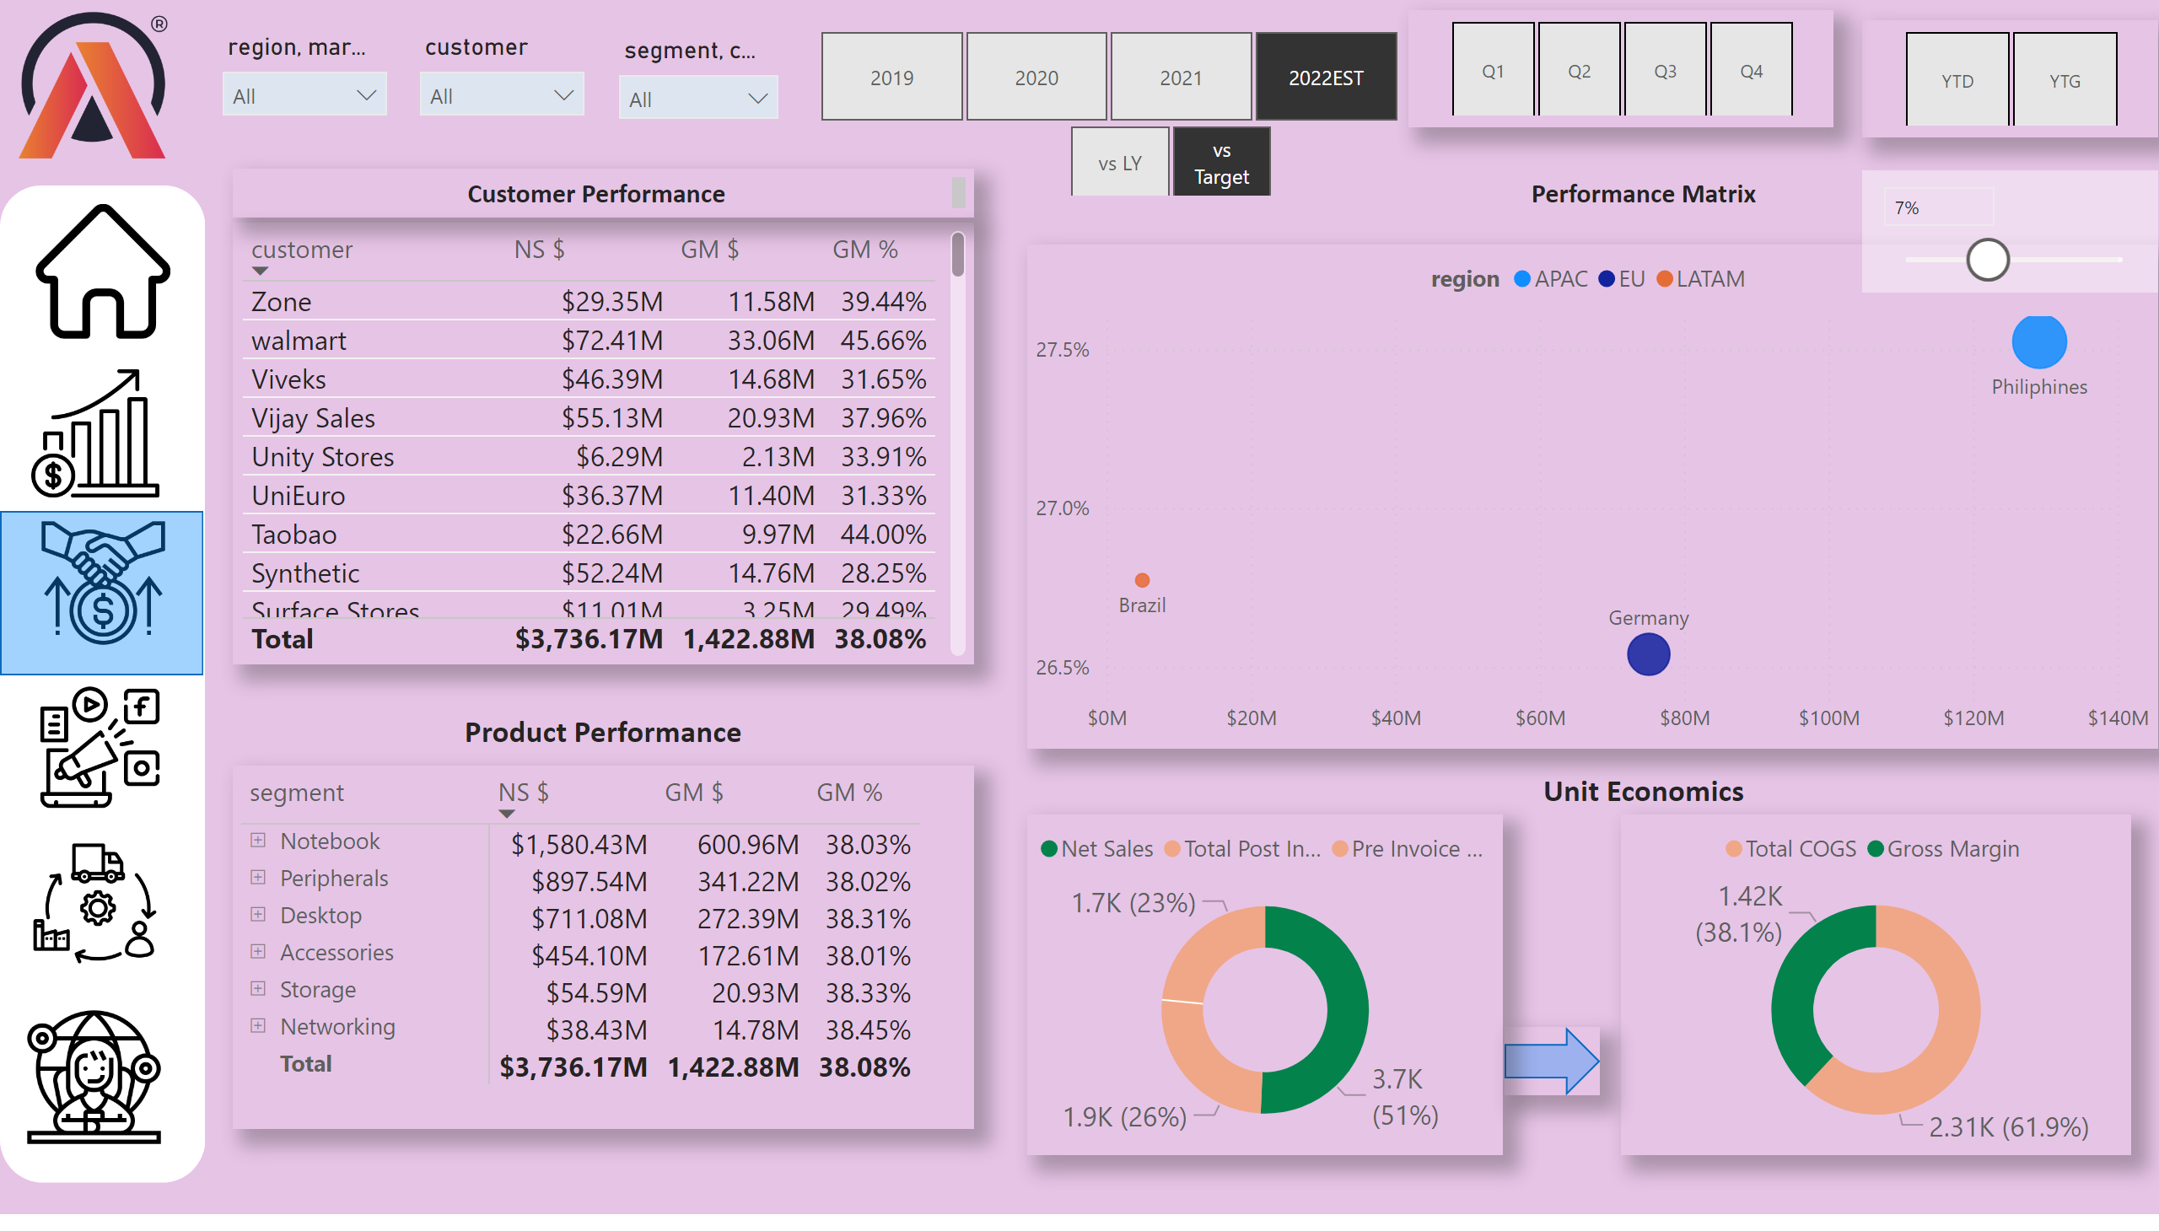
Sales view
Notes:
slicer
No alt text provided
slicer
No alt text provided
slicer
No alt text provided
slicer
No alt text provided
slicer
No alt text provided
slicer
No alt text provided
slicer
No alt text provided
slicer
No alt text provided
image
No alt text provided
shape
No alt text provided
image
No alt text provided
image
No alt text provided
image
No alt text provided
image
No alt text provided
image
No alt text provided
textbox
No alt text provided
shape
No alt text provided
image
No alt text provided
textbox
No alt text provided
textbox
No alt text provided
textbox
No alt text provided
shape
No alt text provided
tableEx
No alt text provided
pivotTable
No alt text provided
scatterChart
No alt text provided
donutChart
No alt text provided
donutChart
No alt text provided

Slide 5
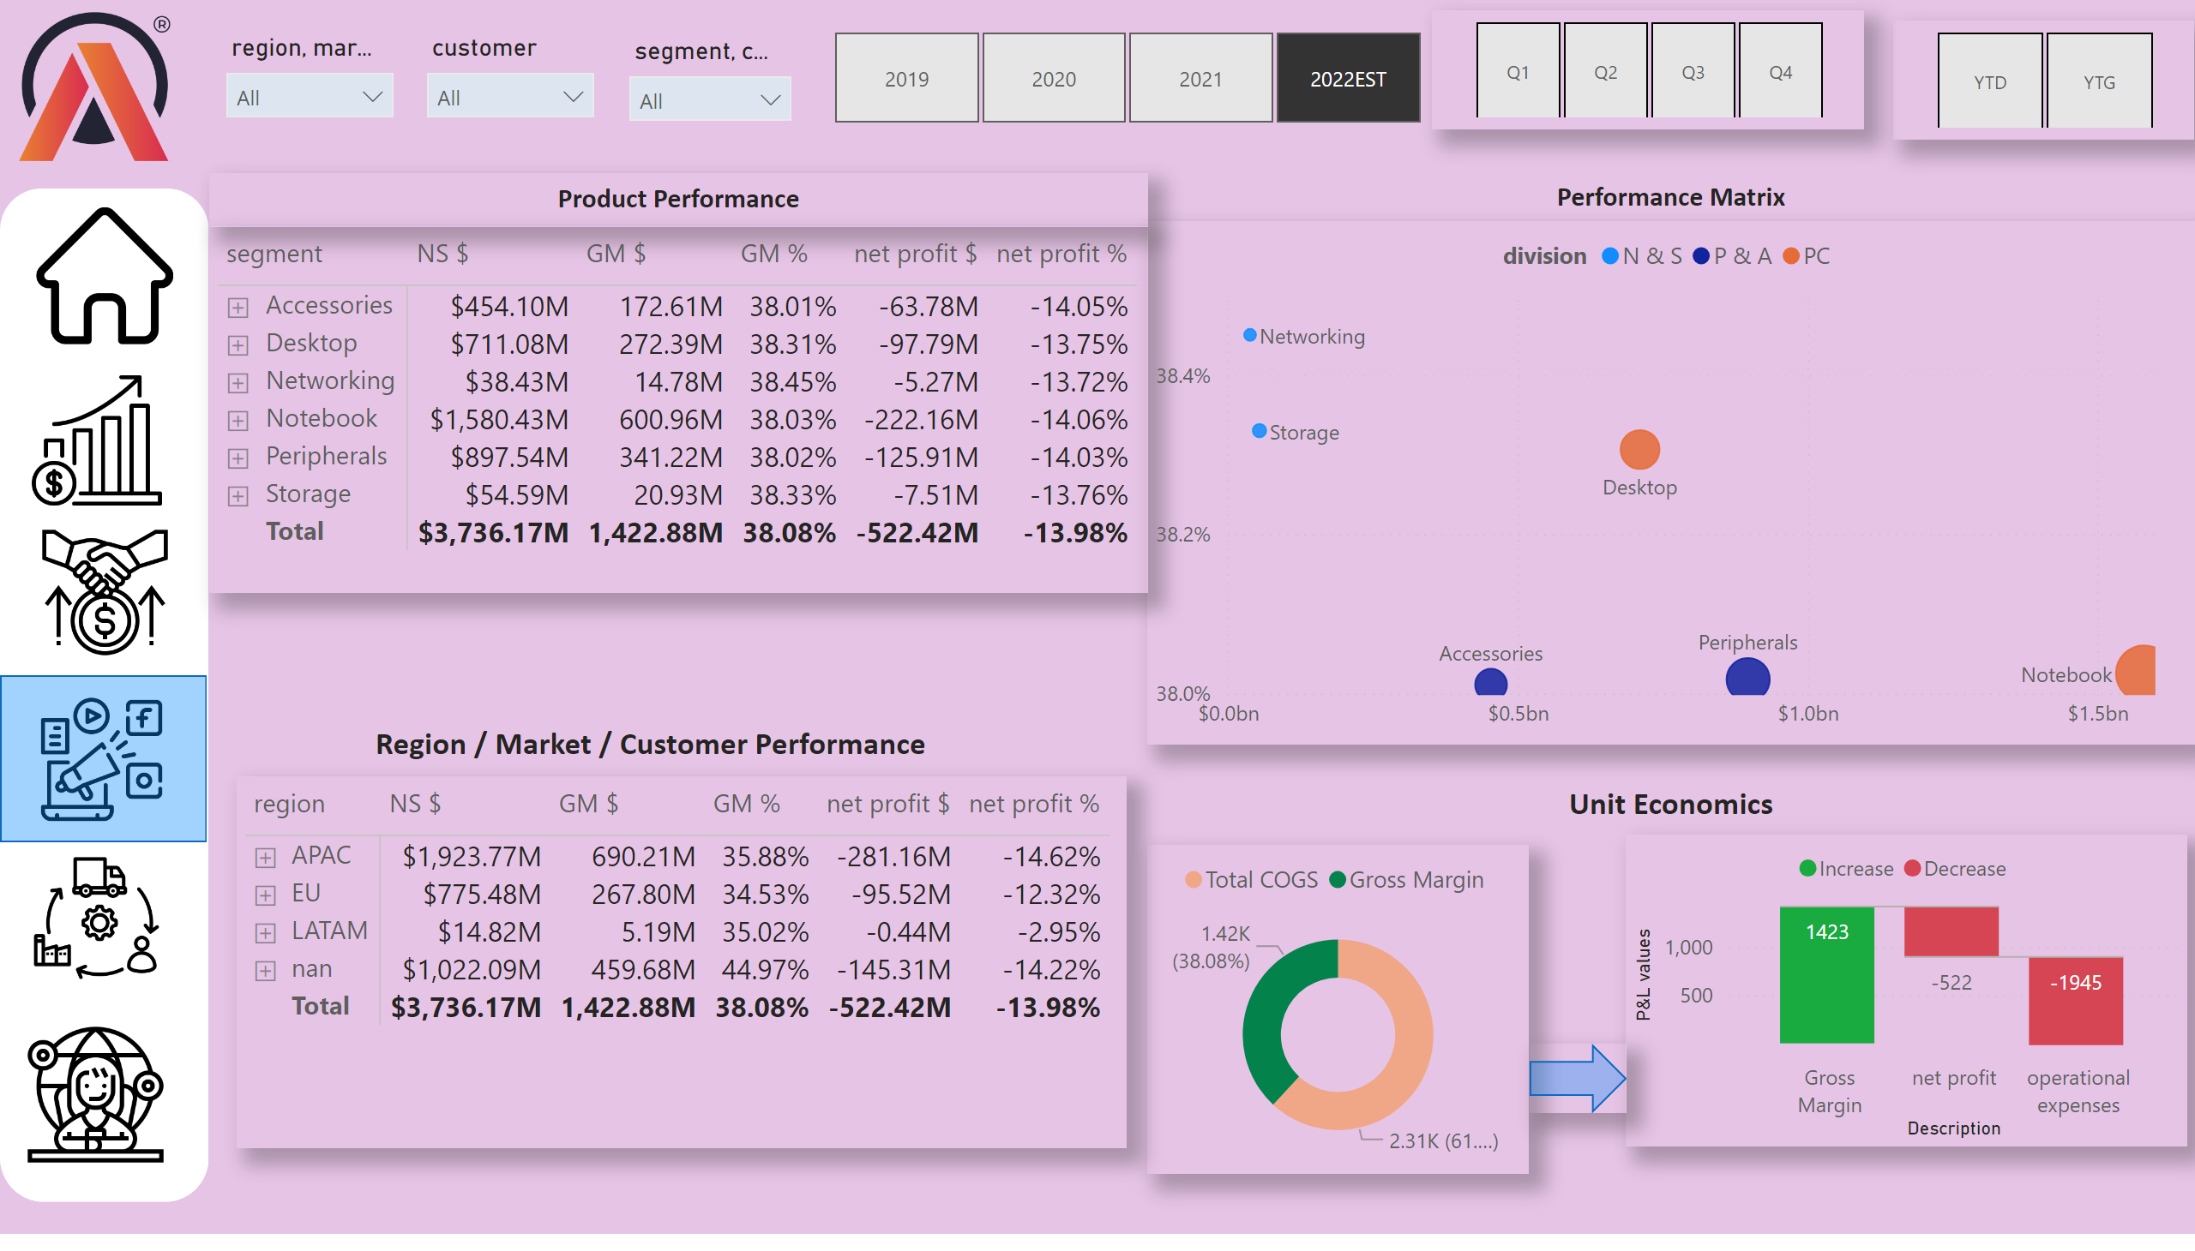
Marketing view
Notes:
slicer
No alt text provided
slicer
No alt text provided
slicer
No alt text provided
slicer
No alt text provided
slicer
No alt text provided
slicer
No alt text provided
image
No alt text provided
shape
No alt text provided
image
No alt text provided
image
No alt text provided
image
No alt text provided
image
No alt text provided
image
No alt text provided
textbox
No alt text provided
shape
No alt text provided
image
No alt text provided
textbox
No alt text provided
textbox
No alt text provided
pivotTable
No alt text provided
pivotTable
No alt text provided
scatterChart
No alt text provided
donutChart
No alt text provided
waterfallChart
No alt text provided
textbox
No alt text provided
shape
No alt text provided

Slide 6
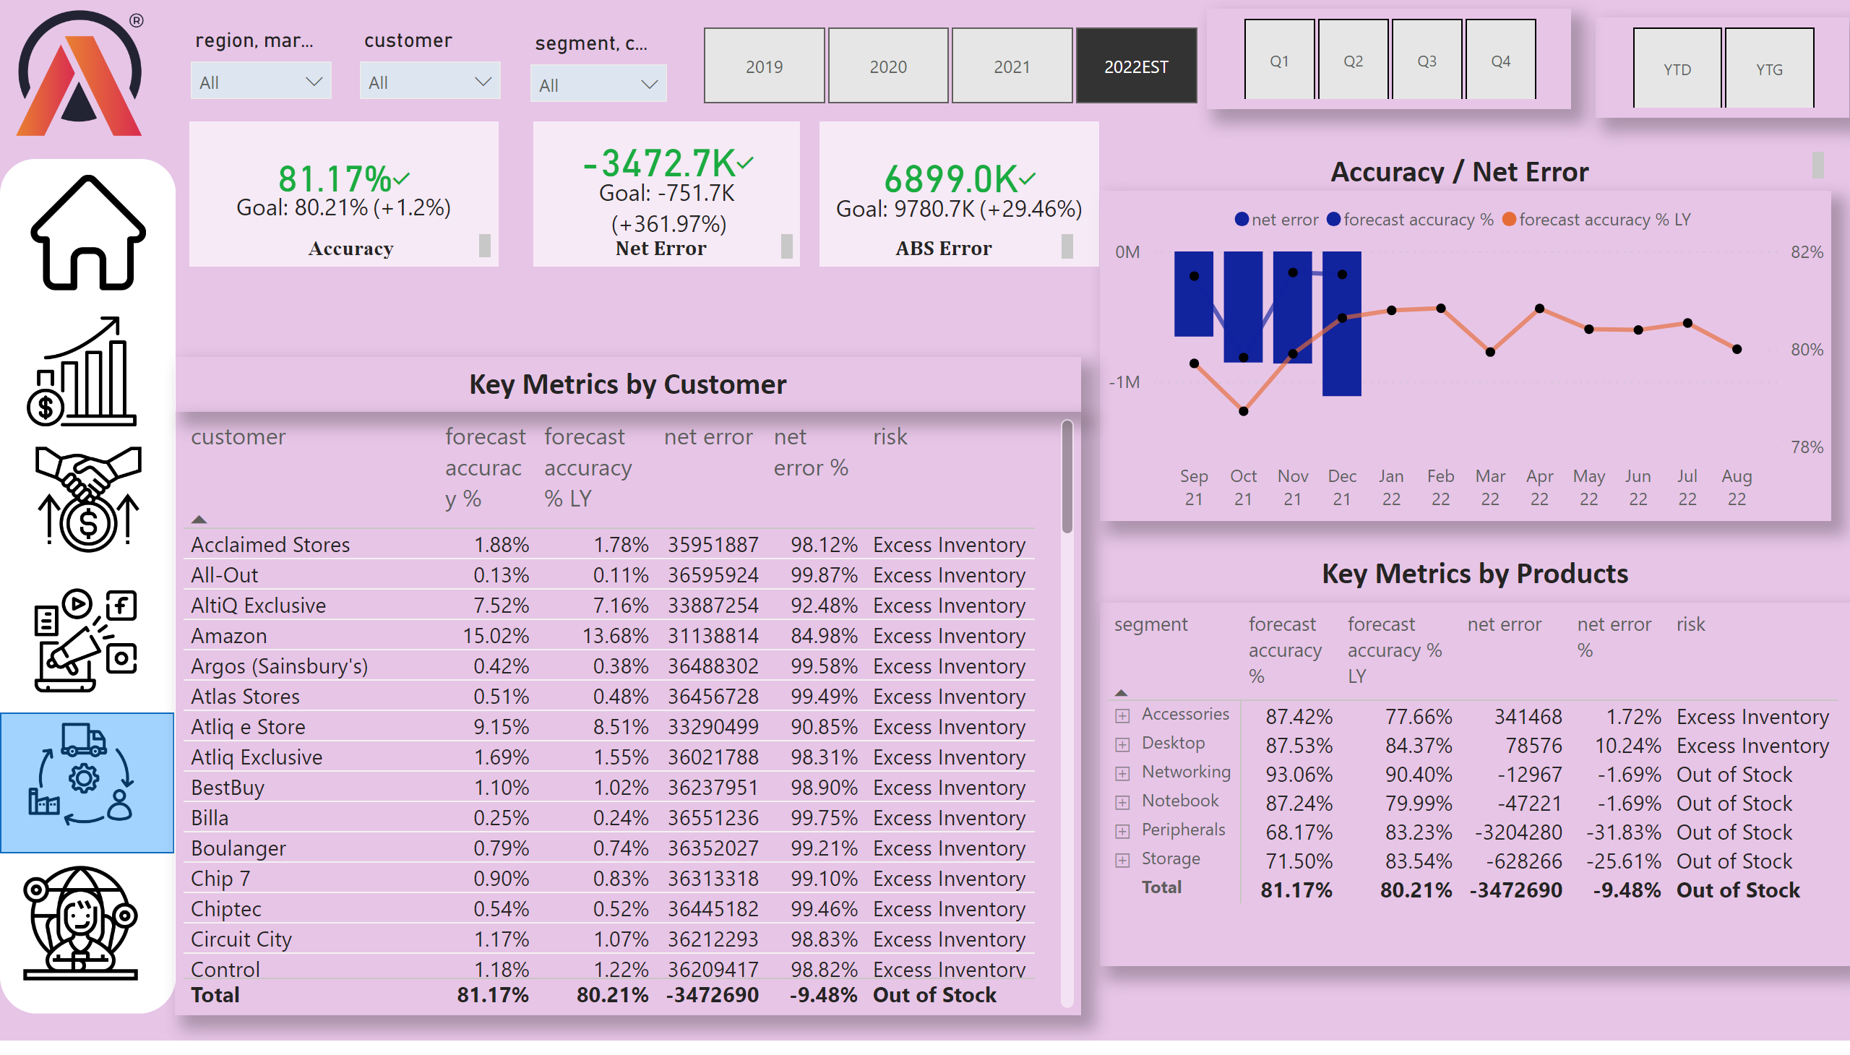
Supply chain view
Notes:
slicer
No alt text provided
slicer
No alt text provided
slicer
No alt text provided
Net SalesPerformance Over Time
No alt text provided
slicer
No alt text provided
slicer
No alt text provided
slicer
No alt text provided
image
No alt text provided
shape
No alt text provided
image
No alt text provided
image
No alt text provided
image
No alt text provided
image
No alt text provided
image
No alt text provided
textbox
No alt text provided
shape
No alt text provided
kpi
No alt text provided
textbox
No alt text provided
kpi
No alt text provided
textbox
No alt text provided
kpi
No alt text provided
textbox
No alt text provided
image
No alt text provided
tableEx
No alt text provided
textbox
No alt text provided
pivotTable
No alt text provided
textbox
No alt text provided

